Slide 1
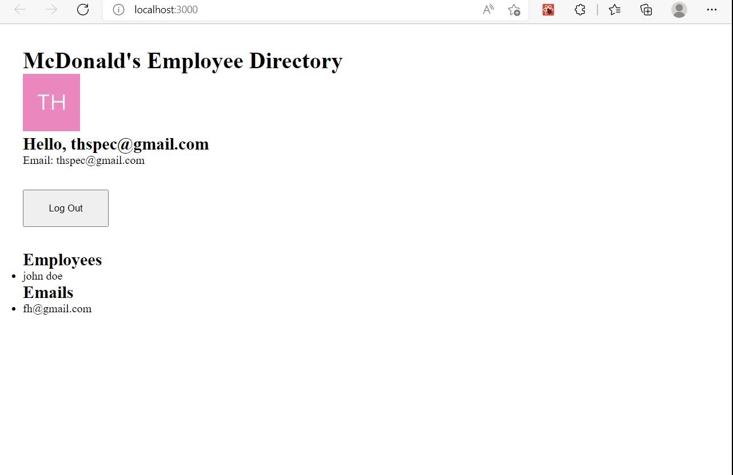
Project 1
Notes:
Team members Mathew Nevish, Rosalinda Gutierrez, Kal McClure, and Latham Graham

Slide 2
Backend
A RESTful API was created using;
Javascript/Typescript for function excution,
Node.js libraries,
Express API,
For the PostgreSQL database.

Slide 3
Front End
Express server were implemented using React.
AWS EC2 was used to remotely access the server.
DevOps pipelines were constructed to Maintain proper CI/CD practices.
DevOps pipelines use Jenkins for testing.

Slide 4
Database
PostgreSQL an object-relational database system
Database contents house proprietary client information
Database provides new password granted security operations.
Source provides Database connectivity and remote communication.

Slide 5
Functionality
Agile/Scrum development methodology was used to facilitate progress.
This development partnership acted as both Owner of the Express server and their partner's Express API.
Projects required thorough documentation and unit testing.
API Clients are able to log into the API and obtain authorized data.

Slide 6
Diagram

